Slide 1
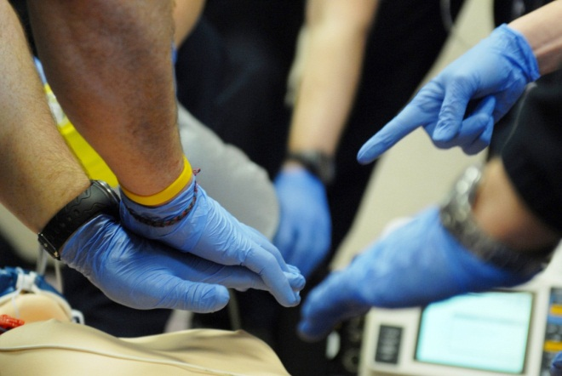
BLS 2015
Cardiovascular Emergencies

Slide 2
Cardiovascular Emergencies
Many different presentations!
45-year-old male with crushing substernal chest pain
50-year-old female with a sudden onset of sharp chest pain and shortness of breath
75-year-old male with hypertension, tachycardia, and shortness of breath
Each of these patients has a cardiovascular emergency – let’s learn more!
Notes:
45 year old male with crushing substernal chest pain: acute MI
50 year old female with a sudden onset of sharp chest pain and shortness of breath: pulmonary embolus
75 year old male with hypertension, tachycardia, and shortness of breath: congestive heart failure

Slide 3
Introduction
Cardiovascular Emergencies
Leading cause of death in the US
Approximately 600,000 people per year
9 out of 10 cardiac arrest victims die before they get to the hospital
Many more people suffer disability
Cost runs into the billions

Slide 4
Practical Skills
To receive CBT or OTEP credit, a trained skills evaluator must evaluate your ability to perform the following hands-on practical skills
Perform focused history using SAMPLE/OPQRST
Assist patient in taking prescribed nitroglycerin
Perform proper technique for auscultating the chest using a stethoscope
Assist a patient with ventilations using a BVM
Demonstrate the ability to care for acute coronary syndrome, CHF, aortic dissection, cardiogenic shock
Demonstrate proper use of AED during CPR

Slide 5
Learning Outcomes
Recognize the structures of the thoracic cavity
Describe the structures of the cardiovascular system
Name the causes of myocardial ischemia
Define acute coronary syndrome
Identify causes of chest pain
Distinguish between the different types of cardiovascular emergencies
Give examples of atypical presentations of AMI.
Demonstrate knowledge of medical history gathering techniques by identifying questions used in the OPQRST method
Determine how to treat a patient with a cardiovascular emergency

Slide 6
TERMS AND DEFINITIONS

Slide 7
Terms
Acute myocardial infarction (AMI) - death of heart muscle caused by blockage in a coronary artery
Acute coronary syndrome (ACS) - term used to describe a range of symptoms and conditions from acute myocardial infarction to unstable angina
Aneurysm - A bulge in the wall of an artery that can burst. If an aneurysm bursts in a vital organ (e.g., brain) or in a major vessel (e.g., aorta), the results can be catastrophic
Angina - Chest pain (with squeezing or tightness in the chest) due to an inadequate blood supply to the heart muscle
Aortic dissection - tear in the lining of the aorta. An aortic dissection can extend to the point that it obstructs arterial blood supply to vital organs

Slide 8
Terms
Asystole - absence of electrical activity in the heart
Atherosclerosis - disease characterized by thickening and destruction of the arterial walls, caused by fatty deposits; arteries lose ability to dilate and carry oxygen-enriched blood
Cardiogenic shock - shock resulting from inadequate functioning of the heart
Congestive heart failure (CHF) - condition characterized by shortness of breath, fluid in the lungs and/or swelling of the body due to water retention usually in the lower legs. It is due to a damaged heart that cannot contract effectively.
Coronary artery disease - disease that causes the arteries that supply blood to the heart muscle to become hardened and narrowed. Also called coronary heart disease.

Slide 9
Terms
Diaphoresis - perspiration or sweating due to a medical condition and not caused by normal exertion
Dyspnea - deep, labored respirations
Dysrhythmia - abnormal heart rhythm, also called arrhythmia
Infarction - death of tissue due to loss of blood flow
Ischemia - poor oxygen supply to tissue
Myocardium - another term for heart muscle
Necrosis - tissue death

Slide 10
Terms
Pedal edema - fluid collecting in the feet which can indicate underlying heart disease. Often seen in CHF
Pulmonary edema - abnormal accumulation of fluid in the tissues and air spaces of the lungs. Pulmonary edema is most commonly associated with acute myocardial infarction or CHF.
Sustained tachycardia - persistent heart rate of 100 or greater caused by a clinical condition such as hypoxia or impending shock
Thrombus - clot formed in a blood vessel or in a chamber of heart
Vasospasm - sudden constriction of a blood vessel
Ventricular fibrillation (VF) - dysrhythmia in which the heart muscle undergoes an ineffective, uncoordinated quivering

Slide 11
ANATOMY

Slide 12
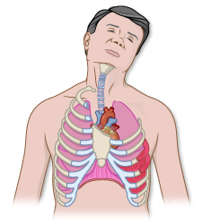
Anatomy
Thoracic Cavity
Neck to lower ribs
Divided into mediastinum and pleural cavities
Diaphragm at its base
Contains trachea, esophagus, heart, aorta, vena cava and the pulmonary artery
Pleural cavities

Slide 13
Anatomy
Structures
12 pairs of ribs
Connect to sternum through a bridge of cartilage
Lower 5 ribs connect to sternum through the costal arch
Intercostal muscles between ribs

Slide 14
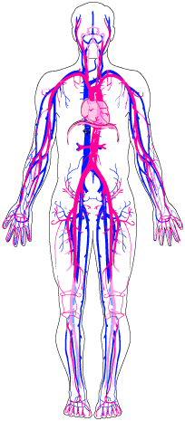
Anatomy
Arteries/Veins
Purpose of cardiovascular system
  Provide cells with oxygen nutrients
  Remove waste
Components
  Heart
  Arteries
  Arterioles
  Capillaries
  Veins
  Venules

Slide 15
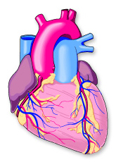
Anatomy
Coronary
Right coronary artery
Left coronary artery
Atria
Ventricles
1
2
3
4

Slide 16
PATHOPHYSIOLOGY

Slide 17
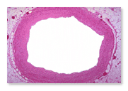
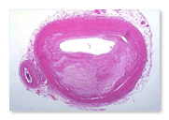
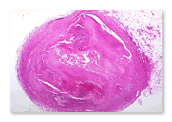
Myocardial Ischemia
Myocardial ischemia is the lack of blood flow and oxygen to the myocardium (heart muscle). There are several causes:
Inadequate blood flow
Constriction or blockage of the blood vessels
Inadequate supply of oxygen
Coronary Artery
75% occluded
Occluded
Notes:
Myocardial ischemia is poor oxygen supply to the heart's muscle tissue. It can be caused by plaque or a clot inside an artery. Plaque is a deposit of fatty material on the inner lining of an arterial wall. An embolus is a fat particle or blood clot that travels from another location in the cardiovascular system. In either case, the substance narrows the inside of the artery and reduces the amount of blood that can pass.
In addition, myocardial ischemia can be caused by a vasospasm. Vasospasm is the narrowing of a blood vessel by tightening or spasm of the muscles within the vessel's wall. Cocaine or methamphetamine use can cause vasospasm.
Other causes of myocardial ischemia include symptomatic hypotension (e.g., blood loss), symptomatic tachycardia, or symptomatic bradycardia due a medical condition such as CHF. Severe anemia (lack of sufficient red blood cells) can be a cause, too.

Slide 18
Coronary Thrombosis
One of the major causes of myocardial ischemia
Recent scientific research has expanded our understanding
This research has discovered the steps to thrombosis formation

Slide 19
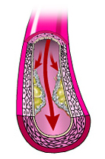
Coronary Thrombosis
1
Plaque forms on the
inner wall of an artery
Notes:
The first step is the formation of a plaque on the inner wall of an artery. This may occur due to stress on the internal lining of the artery from:
high blood pressure
high lipids in the blood
diabetes
smoking
genetic factors
Plaque is a deposit of a fat-like substance that is hard on the outside and soft on the inside

Slide 20
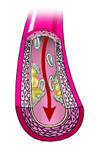
Coronary Thrombosis
1
2
Hard surface of the
plaque tears, exposing
the soft under side
Notes:
Plaque is disrupted or the inner lining of the artery overlying the plaque is eroded away. The plaque can eventually burst or tear. This creates a "snag" where a clot forms.

Slide 21
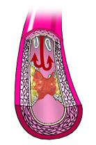
Coronary Thrombosis
1
Platelets arrive to
form a blood clot
2
3
Notes:
Platelets and other components (fibrin) in the blood immediately react to the newly exposed layer and a clot begins to form. Depending on the size of the rupture, blood flow can begin to diminish beyond the site. This reduces the oxygen delivery to the myocardium. At some point the oxygen supply is reduced enough to cause chest pain or other symptoms.

Slide 22
Atherosclerosis
Can also cause myocardial ischemia and chest pain
No disruption of plaque
Stable plaque that increases in size over time
Decreases blood flow past the obstruction
Example: angina
Notes:
In this case, the reduced oxygen delivery can meet the myocardial demand while the patient is at rest, but can fall short with exertion. The patient can then develop chest pain as with angina. This chest pain should resolve with either decreasing the workload, stopping exertion and resting, or by increasing the blood flow past the stable plaque by taking nitroglycerin, which causes the artery to dilate. However patients with angina are at higher risk of clot formation and heart attack.

Slide 23
Vasospasm
Can also cause myocardial ischemia and chest pain
No disruption of plaque
Spasm of a coronary artery cuts off blood supply to the myocardium
Example: cocaine use
Notes:
Vasospasm can be caused by drugs such as cocaine. Prinzmetal's angina is chest pain caused by a spasm of the artery that acutely reduces or stops blood flow through the artery.

Slide 24
Causes of Chest Pain
Not all chest pain is cardiac!
Chest wall
Lung and pleura
Mediastinum
Abdomen
Psychogenic
Notes:
Chest Wall
traumatic contusion
muscle strain
overuse syndromes such as rotator cuff tear with pain radiating from the shoulder
breast cysts and infections
shingles
inflammation of rib cartilage
Lungs and Pleura
pleurisy
pneumonia
pneumothorax
pulmonary embolus
asthma, bronchitis, upper-respiratory infection
Mediastinum
angina
unstable angina (pre-infarction angina)
myocardial infarction
esophagitis, esophageal spasm, heartburn, reflux (GERD)
pericarditis
mediastinal air from ruptured bronchus
Abdomen
gallbladder (cholecystitis, gallstones)
stomach (gastritis)
pancreas (pancreatitis)
Psychogenic chest pain (non-organic, psychosomatic)
stress
hyperventilation
panic attack

Slide 25
ACUTE CORONARY SYNDROMES

Slide 26
Acute Coronary Syndrome
Includes a range of conditions from angina to acute MI. The symptoms, which vary from patient to patient, are caused by acute myocardial ischemia:
  Shortness of breath
  Discomfort
  Chest pain
  Pressure
  Nausea
  Weakness
  Dysrhythmia
  Syncope
Notes:
In many cases, it is not possible to distinguish between angina, acute coronary syndrome, and a myocardial infarction based simply on a history and exam. Paramedic’s 12-lead EKG, bloodwork at the hospital, and even an angiogram may provide the diagnosis in a patient with ongoing pain or other related symptoms.

Slide 27
Angina
Chest pain or other cardiac symptoms due to myocardial ischemia. Typically anginal attacks are:
  Brought on by exercise or other stress
  Usually relieved by rest and/or nitroglycerin
  Unstable angina may occur at rest or may not be relieved by rest or nitro
Notes:
There is typically a regular pattern to stable angina. It can be triggered by physical exertion, stress, even cold weather or eating a large meal. Unstable angina is angina that comes on at rest, lasts longer than normal, or is not relieved by rest or nitro. Unstable angina is concerning because it can sometimes be a precursor to a myocardial infarction.

Slide 28
Acute Myocardial Infarction
Occurs when a coronary artery is completed blocked, and the area beyond that artery becomes starved for oxygen, causing pain. If unrelieved, the area deprived of blood flow will die.
  Chest pain is usually described as “heavy,” “pressure,” or “squeezing.”
  Pain is less commonly “sharp” or “stabbing”
  Pain may radiate to left shoulder, arm, neck, jaw, or may occur in the epigastric area
  Associated symptoms: dyspnea, nausea, diaphoresis, “feeling of impending doom.”

Slide 29
Atypical Presentations
Atypical presentations of cardiac pain may occur in *anyone* but are more common in the elderly, diabetics and women
Classic Symptoms | Atypical Symptoms
Pressure, fullness, heaviness, squeezing pain in center of chest that can radiate to neck, shoulder, jaw or back Sweating Nausea Weakness Shortness of breath | Unusual fatigue Sudden onset of unusual SOB during usual activities or at rest Nausea, dizziness Belching, burping, indigestion Palpitations, new dysrhythmia, esp. atrial fibrillation Pain experienced only in jaw, neck, back, arm or wrist

Slide 30
OTHER CARDIOVASCULAR
EMEGENCIES

Slide 31
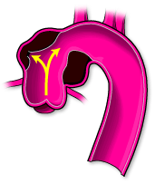
Aortic Dissection
Occurs when when there is a tear in the inner wall of the aorta, causing blood to leak and tear (“dissect”) in either direction. Presentation varies depending on where the vessels has torn.
  Severe, tearing pain in the
  upper back
  Cardiac-type chest pain
  Stroke-like symptoms
  Differing blood pressures between right
  and left arms
  If the tear is very large, the patient may die
Notes:
Patients can present with a variety of signs and symptoms. If the tear is large or the aorta ruptures, the patient may die within a few minutes. Most patients present with sudden severe chest pain, often described as “tearing” or “ripping” and radiating through to the back. If the dissection extends into the coronary arteries, the person may present with chest pain similar to an MI. If the dissection extends into one subclavian artery, the blood pressures may be different between the right and left arms. If the dissection extends into the carotid arteries, the patient may develop stroke-like symptoms.

Slide 32
CHF
Occurs when the heart is too weak to adequately circulate blood (often due to an MI).
Left-sided heart failure causes fluid to back up into the lungs.
Right-sided heart failure causes fluid to back up into the venous system.
Many patients have a combination of both types of failure. Presentation includes:
  Dyspnea
  Pulmonary edema (heard as rales)
  Chest pain
  Hypertension
  Swollen ankles (if there is a component of right-sided heart failure)

Slide 33
Cardiogenic Shock
Occurs when heart is seriously weakened and cannot pump enough blood to perfuse body. This may occur after an MI. Presentation is similar to other types of shock:
  Hypotension
  Chest pain
  Bradycardic/tachycardic/other arrhythmias
  Restless, anxious
  Pale, cool skin
  Possibly altered LOC
Notes:
This condition can be brought on when approximately 40% of the left ventricle is involved with an AMI. It can also be caused by disorders of the heart muscle, the valves or the heart's electrical conduction system. Cardiogenic shock has a very high mortality rate.

Slide 34
Pulmonary Embolus
Pulmonary embolus occurs when a blood clot travels from somewhere in the body (usually the legs or pelvis) and lodges in the pulmonary vasculature. Presentation varies by the size of the clot. A very small clot may cause mild dyspnea, a very large clot may cause sudden death. Other presentations include:
  Dyspnea
  Chest pain, often sharp in nature
  Usually, clear lung sounds (remember, this is a vascular problem, not a lung tissue problem!)
  Tachycardia
  Hypotension
  Pale, cool skin
  Low oxygen saturations (check before administering oxygen)
Notes:
Clots usually form in the deep veins of the legs or pelvis, and may occur following surgery or prolonged sitting (such as a long airplane flight). Other risk factors include woman who are taking birth control medication, and the morbidly obese. Once the clot forms in the vein it may break off the vessel wall and float through the circulation until it lodges in an organ.

Slide 35
Hypertensive Emergencies
Very high blood pressure associated with neurologic findings.
  Generally higher than 180/120
  Unilateral weakness
  Visual disturbances
  Severe headache
  Seizure

Slide 36
PATIENT CARE

Slide 37
Initial Assessment
  Guides initial treatment
  Quickly assess a patient
  Make a decision
SICK
or
NOT SICK
Notes:
The SICK/NOT SICK choice is a very important medical decision. In some cases, it is a life-saving choice. You should be able to decide within the first minute of contact whether or not the patient is critically ill. You do this by forming a clinical picture. Once the decision is made, responder actions should proceed in a manner appropriate to the patient's condition.

Slide 38
SICK/NOT SICK
SICK patient is one who can die quickly unless you initiate aggressive BLS and ALS treatment and rapid transport
NOT SICK patient is one who can be ill or injured, but not severely enough to need immediate ALS care

Slide 39
Key Clinical Indicators
  Respirations (rate, character)
  Pulse (rate, character)
  Mental status
  Skin signs and color
  Body position
SICK
or
NOT SICK

Slide 40
OPQRST: Patient History
OPQRST
Onset | What was patient doing when the pain started?
Provocation | What makes it better or worse?
Quality | Can you describe it? What does it feel like?
Radiates | Where do you feel it? Where does it go?
Severity | How bad is it on a scale of 1 to 10 (ten being the worst)?
Time | When did the pain begin?

Slide 41
Physical Exam
  Auscultate breath sounds starting at the bases
  BP in both arms (note difference of 10 mm Hg or more)
  Skin color, moisture and temperature
  Pulse oximetry
  Blood glucometry
  Head, neck-to-toe exam

Slide 42
LUNG SOUNDS

Slide 43
Lung Sounds
  Listen at six locations on the back and four locations on the front
  Start in the back at the base first in sitting patient
  Instruct patient to take a deep breath through the mouth then exhale
  Listen to one or two inspiration/expiration cycles per location
  Move to the other side and compare
  Try to avoid listening through clothing

Slide 44

Lung Sounds - Example
Normal lung sounds – recorded over the left anterior upper chest of a 15 year old male adolescent
(click the sound button to play)

Slide 45
Lung Sounds - Example
Rales – These crackles and bronchial breathing were recorded posteriorly over the consolidated left lower lung of a 65-year-old male with CHF
(click the sound button to play)

Slide 46
Lung Sounds - Example
Rales – These late inspiratory fine crackles were recorded over the right posterior lower lung of a 55 year old woman with CHF
(click the sound button to play)

Slide 47
Lung Sounds - Example
Wheeze (a) – This expiratory wheezing was recorded over the right anterior upper chest of an 8 year old boy with asthma
(click the sound button to play)

Slide 48
Lung Sounds - Example
Wheeze (b) – These wheezing & coarse crackles were recorded over right posterior lower lung of an 8 month old boy with viral bronchiolitis
(click the sound button to play)

Slide 49
Patient Care
General steps
  Decide SICK or NOT SICK
  Ensure adequate airway and respirations
  Administer oxygen
  Position appropriately
  Assure ALS response if appropriate

Slide 50
Patient Care
Other considerations
  Control airway secretions
  Assist ventilations with BVM if needed
  Prepare for cardiac arrest and application of an AED

Slide 51
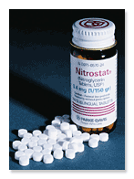
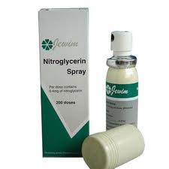
Nitroglycerin
  Used to treat angina
  Relaxes vascular muscles
  Increases blood flow & oxygen to myocardium
Notes:
These conditions must be met before you may assist with nitro:
complaint similar to normally experienced angina or cardiac pain
BP greater than 100 mmHg systolic
no more than three doses total (5 minutes apart)
must be patient's prescription
patient must be sitting or lying down
no Viagra or Levitra within past 24 hours or Cialis within past 48 hours

Slide 52
Nitroglycerin
You may assist a patient in taking prescribed nitroglycerin if:
  Pain is the same for which nitroglycerin is normally taken
  Patient’s BP is greater than 100 mmHg systolic
*Follow your local protocol if different.
Notes:
These conditions must be met before you may assist with nitro:
complaint similar to normally experienced angina or cardiac pain
BP greater than 100 mmHg systolic
no more than three doses total (5 minutes apart)
must be patient's prescription
patient must be sitting or lying down
no Viagra or Levitra within past 24 hours or Cialis within past 48 hours

Slide 53
Nitroglycerin
“Assisting” a patient with nitroglycerin means you can:
  Locate the container
  Open it
  Offer a pill to the patient

Slide 54
Aspirin in the Field
Why give aspirin to someone with acute coronary syndrome (angina or MI)?
  Anti-inflammatory properties
  Helps protect inflamed heart muscle
  Reduces body’s production of prostaglandins
    May reduce risk of blood clots, heart attacks, strokes
  Anti-platelet effect takes an hour to “kick in”

Slide 55
Aspirin in the Field
Give one, non-coated 325 mg or four 81 mg aspirin to a patient who has any of following signs or symptoms of acute coronary syndrome
  Uncomfortable pressure, fullness, squeezing or pain in the center of the chest that lasts more than a few minutes, or goes away and comes back
  Pain that spreads to the shoulders, neck or arms
  Chest discomfort with lightheadedness, fainting, sweating, nausea or shortness of breath

Slide 56
Aspirin in the Field
Also give an aspirin to patient who exhibits any TWO of the following signs or symptoms when acute coronary syndrome is suspected:
Atypical chest pain, stomach or abdominal pain
  May include discomfort that can be localized to a point, that is “sharp” in nature, that is reproducible by palpation or that is in the “wrong” location (such as upper abdomen)
Unexplained nausea (without vomiting) or lightheadedness (not vertigo) without chest pain
Shortness of breath and difficulty breathing without chest pain
Unexplained anxiety, weakness or fatigue
Palpitations, cold sweats or paleness

Slide 57
Aspirin in the Field
How to administer aspirin
Be sure the patient is alert and responsive.
Ask the patient to swallow one, non-coated 325 mg aspirin tablet (or four 81 mg tablets) with water.
If the patient has a prescription for nitroglycerin and meets the criteria for administration, do not delay in assisting with nitroglycerin.
Request a paramedic response if paramedics were not dispatched.
Record your actions, including the dosage and the time of administration

Slide 58
Summary
Myocardial ischemia is the lack of blood flow and oxygen to the heart muscle.
Acute coronary syndrome (ACS) is the term used to describe clinical conditions ranging from unstable angina to acute myocardial infarction.
Sources of non-cardiac chest pain include the mediastinum, chest wall, lungs/pleura and abdomen.
Common cardiovascular emergencies are angina, AMI, aortic dissection, CHF and cardiogenic shock.
Your evaluation of a patient with a cardiovascular emergency can be critical. Your treatment may include the administration of nitroglycerin and aspirin.

